Slide 1
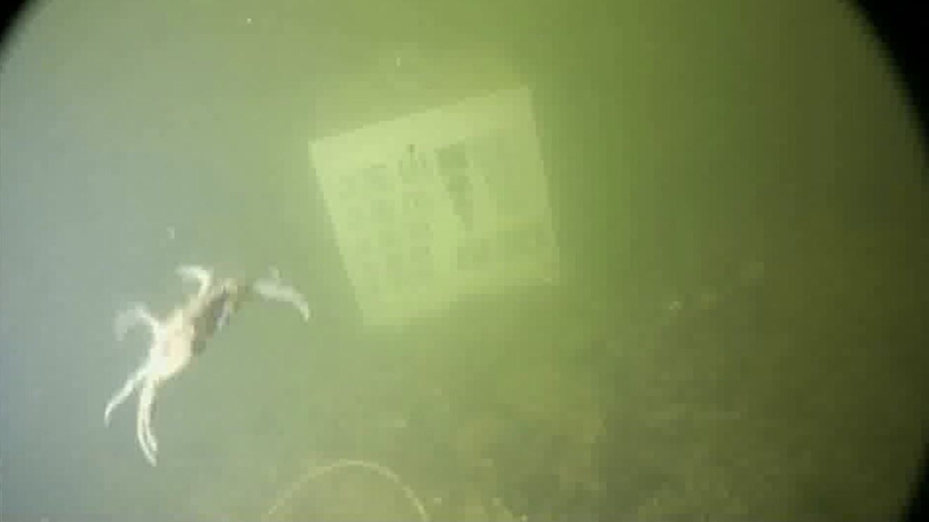
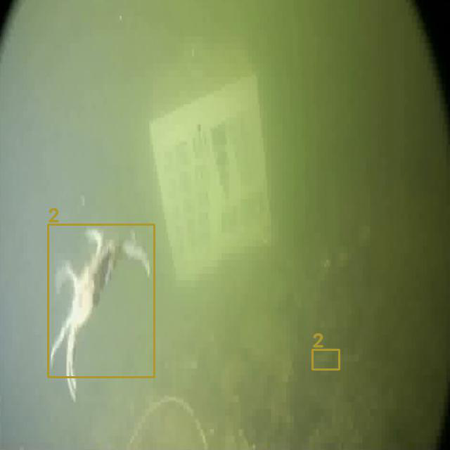

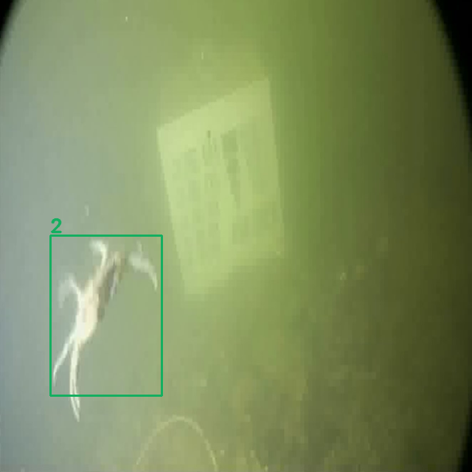

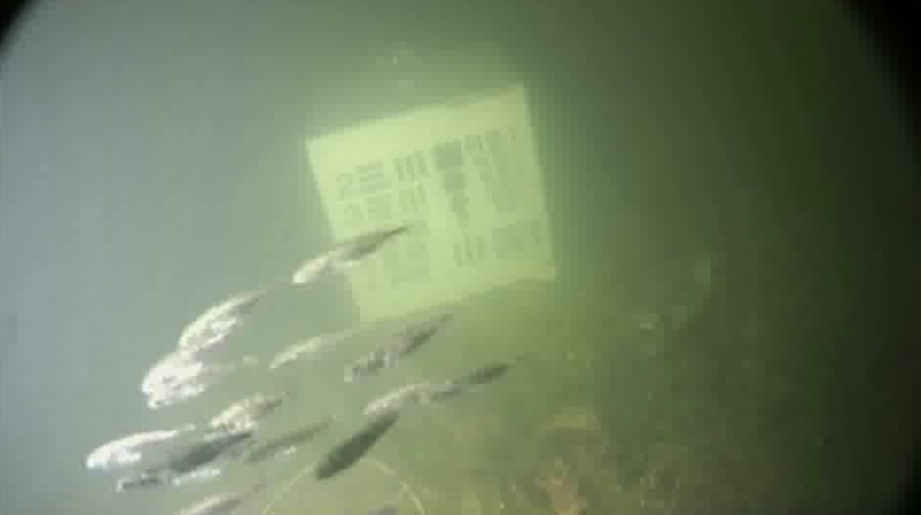
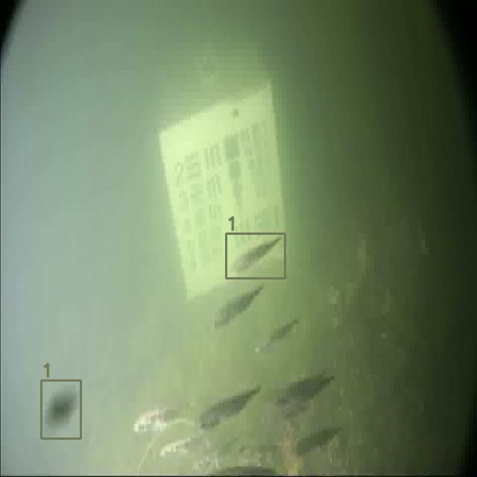

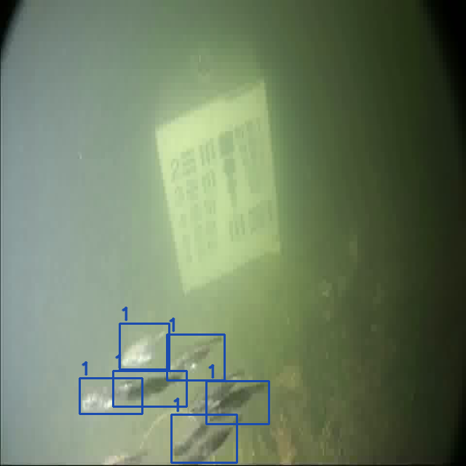

Model Used | Original Image | Predicted | Features GradCAM++ with Localisation
YOLOv8, “Crab”
EfficientDet, “Crab”
YOLOv8, “Fish-School”
EfficientDet, “Fish-School”

